Slide 1
Libyan Essential Package of Health Services and
Normative Cost Analysis of Primary Health Care
For the Libyan Population and for Migrants.
October 23, 2022

Slide 2
Objectives
To estimate the incremental financial cost of implementing of an adapted Essential Package of Health Services (EPHS) under the Better Lives Program in Libya
To investigate the primary care package, not hospital services, being provided to the general Libyan population and migrants. To address the healthcare needs of migrants relative to the Libyan population - presenting the costs of migrant health as a subset of the broader EPHS package
To maximize the value of inputs (14 million GBP annually) from UK-FCDO in supporting the delivery of the EPHS.

Slide 3
Scope of the Costing
The scope of costing Primary Health Care in Libya at the health center level includes the following:
Expenditures on the drugs and other supplies which will be required to implement the selected EPHS interventions in all project health institutions - The Libyan Essential Medicine List (2019) is the primary reference for drugs and supplies
Includes Physical infrastructure and equipment for the delivery of Primary Healthcare services at Health Center Levels
Recurrent costs related to running health institutions
Human resource costs (related to top-ups/staff incentives) - health centers being staffed by specialists and general practitioners, hospitals staffed by nurses, midwives, dentists and other technicians and doctors. According to SARA, 50% of the workforce are non-health staff

Slide 4
Costing Methods and Approach
Resource costs (Human Resources, drugs and medicines and supplies, infrastructure refurbishment, logistics, etc.) are estimated using the One Health Tool (OHT) and results are presented in Excel and Word report.
Human resource counts for each of the 3 facility levels detailed by Libyan MoH in 2018. Estimated monthly salaries for staff have been indicated and allocated according to decree 418 of the Ministry of Health
SARA applied for primary health care facility costs (Health Unit = 728, Health Center = 571, Polyclinic = 56). An additional sensitivity analysis was conducted using data from the Ministry based on facility to population ratio (1 Health Unit:15,000 pop., 1 Health center:25,000 pop., and 1 Polyclinic:50,000 pop.)
This is assuming all health facilities are functioning
Drugs and Medicines estimated at 28% of annual facility budgets
Recurrent expenditures at 3% of annual facility budgets
Infrastructure and equipment estimated at 8% of annual facility budgets due to depreciation cost

Slide 5
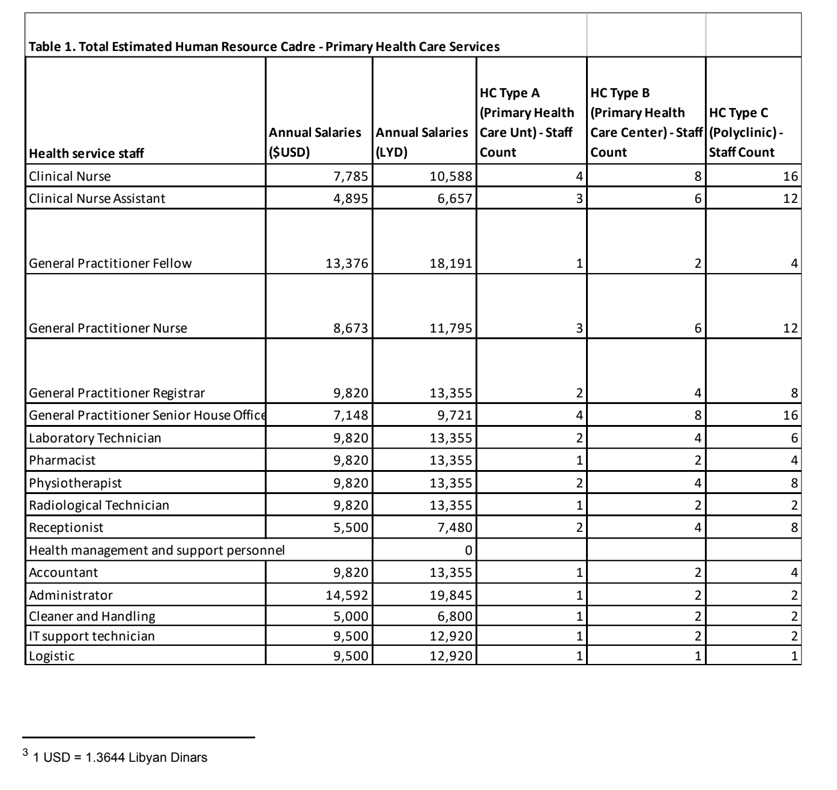

Slide 6
Cost Scenarios (Libya PHC)
Full cost estimate covered under 2 different scenarios:
Scenario 1 was full 100% coverage of PHC across the Libyan Population by 2025
Scenario 2 is 80% coverage of PHC across the Libyan population by 2025

Slide 7
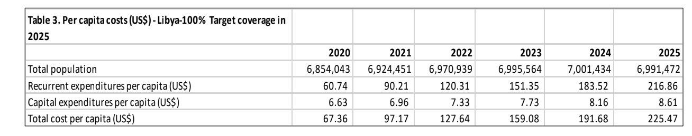
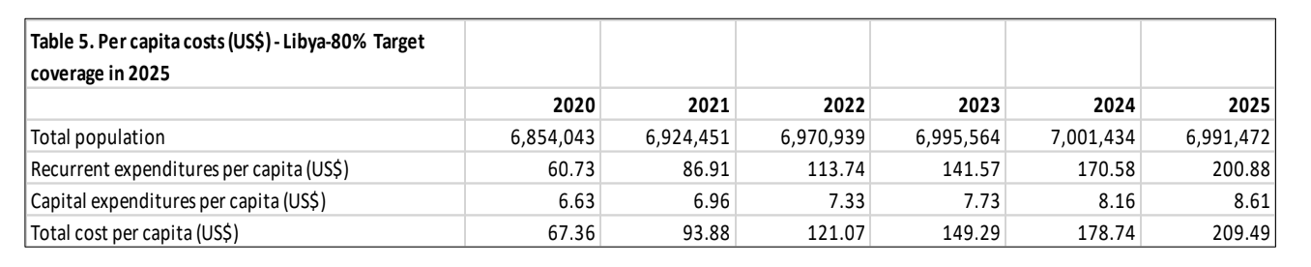
Cost Scenarios 1 and 2 (Comparison)

Slide 8
Results – Scenario 1
Scenario-1 costs (USD)
Cost item | 2020 | 2021 | 2022 | 2023 | 2024 | 2025 | Total
Human Resources | 249,958,750 | 364,823,575 | 482,132,021 | 604,825,193 | 730,144,134 | 859,030,177 | 3,291,913,849
Total Infrastructure | 61,590,400 | 67,152,835 | 71,901,346 | 76,777,202 | 81,783,155 | 86,922,016 | 446,126,954
Total Logistics | 30,028,939 | 48,177,143 | 66,943,277 | 86,252,287 | 106,021,880 | 126,087,125 | 463,510,649
Total Medicine, commodities and supplies | 120,115,756 | 192,708,570 | 267,773,106 | 345,009,147 | 424,087,519 | 504,348,499 | 1,854,042,597
Total cost USD | 461,693,845 | 672,862,123 | 889,749,750 | 1,112,863,829 | 1,342,036,688 | 1,576,387,817 | 6,055,594,049

Slide 9
Results – Scenario 2
Scenario-2 costs (USD)
Cost item | 2020 | 2021 | 2022 | 2023 | 2024 | 2025 | Total
Human Resources | 249,958,750 | 364,823,575 | 483,132,021 | 604,825,193 | 730,144,134 | 859,030,177 | 3,291,913,849
Total Infrastructure | 61,590,400 | 67,152,835 | 71,901,346 | 76,777,702 | 81,783,155 | 86,922,016 | 446,126,954
Total Logistics | 30,025,249 | 43,611,464 | 57,793,198 | 72,558,728 | 87,900,630 | 103,737,529 | 395,626,797
Total Medicine, commodities and supplies | 120,100,996 | 174,445,855 | 231,172,791 | 290,234,911 | 351,602,520 | 414,950,115 | 1,582,507,187
Total cost USD | 461,675,395 | 650,033,729 | 843,999,356 | 1,044,396,034 | 1,251,430,439 | 1,464,639,837 | 5,716,,174,787

Slide 10
Cost Analysis of Services for Migrants in Libya
The scope of costing Primary Health Care in Libya at the health center level includes the following:
Country-wide projection is applied - multiplies population in need by this proportion, intervention by intervention - looked at interventions and estimated the % by the age range of migrants - 7,000 women 20 - 24 years old
Use of the EPHS costing conducted for the MoH in 2020
Only 10% of migrants of women compared to 50% for the total Libyan population
Based on the assumption that migrants will access services the same way as Libyan nationals - use pattern will be different in migrant population will be different due o age and demographics
Calculated by comparing demographic breakdown of migrants with demographic assumptions fed into the One Health Tool used for costing the Libya EPHS - calculates proportional use of services by migrants

Slide 11
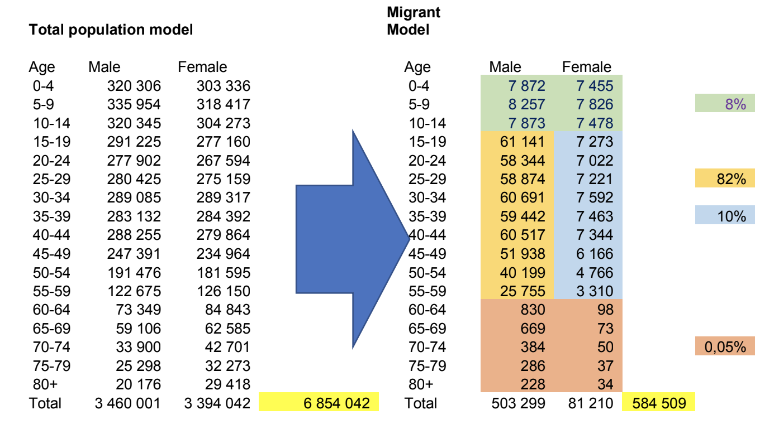

Slide 12
Summary Costs (USD) for migrants (Libya) - 100% target coverage by 2025
Migrants cost (USD)
Cost item | 2020 | 2021 | 2022 | 2023 | 2024 | 2025 | Total
Human Resources | 21,218,281 | 30,968,827 | 41,011,692 | 51,341,876 | 61,979,842 | 72,920,608 | 279,441,126
Total Infrastructure | 3,153,915 | 3,625,624 | 4,110,773 | 4,609,663 | 5,122,593 | 5,649,875 | 26,272,444
Total Logistics | 1,726,542 | 2,810,018 | 3,935,396 | 5,097,734 | 6,292,204 | 7,512,449 | 27,374,343
Total Medicine, commodities and supplies | 6,906,168 | 11,240,073 | 15,741,583 | 20,390,936 | 25,168,818 | 30,049,795 | 109,497,372
Total cost USD | 33,004,906 | 48,644,542 | 64,799,444 | 81,440,209 | 98,563,457 | 116,132,727 | 442,585,285

Slide 13
Conclusions
The above analyses reflect the primary trade-offs associated with delivering the revised EPHS in the Libyan context based on key assumption, norms, and standards of service delivery, associated with the Libyan EPHS and Migrant goals for 2025
Any additional considerations to reducing or modifying the overall cost will need to address the list of interventions delivered and levels of staffing at health facilities, both of which will impact the ability to work towards achieving Universal Health Coverage of the Libyan population by 2025
Finally, once the final determinations are made, the next step will need to consider the operationa of these resources to maximize the reach the Libyan population through efficient and cost-effective implementation.

